Slide 1
Electric Blue
Lessons from a Blue team securing Azure
Notes:
Hi and Welcome to my presentation: Electric Blue – Lessons from a Blue team securing Azure

Slide 2



About Me
Notes:
I’m currently a Senior Security Analyst working in the SOC of a financial institution
I’ve previously worked in IR, Red Teaming and Infrastructure Engineering for the Government
All the opinions presented throughout this presentation are my own, and do not reflect any employer of mine, past or present.

Slide 3

It looks like you’re trying to build a cloud environment.
Would you like help?
Notes:
The aim of this talk is for those who are looking to build an Azure environment
Those that may already have one, may find some useful takeaways as well
Going to cover some of the useful tips we wish we had of been told from the start
Not going to be covering AAD and Office365 – lots of talks already cover these aspects

Slide 4













Goal
Notes:
A project was stood up to support a multi-cloud tenancy, there is a lot of reasons for this:
Redundancy
Regulation
Reducing Risk
Every cloud environment has their own advantages
The question was asked of the SOC: what measures can we implement to ensure the platform is secure?
For staff users
For customers
For those managing the platform
The SOC had its own requirements it wanted to fulfil
We didn’t want to have another portal we had to monitor – we wanted integration into our SIEM for active alerting
We wanted to set practices and conditions from the beginning to ensure good behaviour

Slide 5
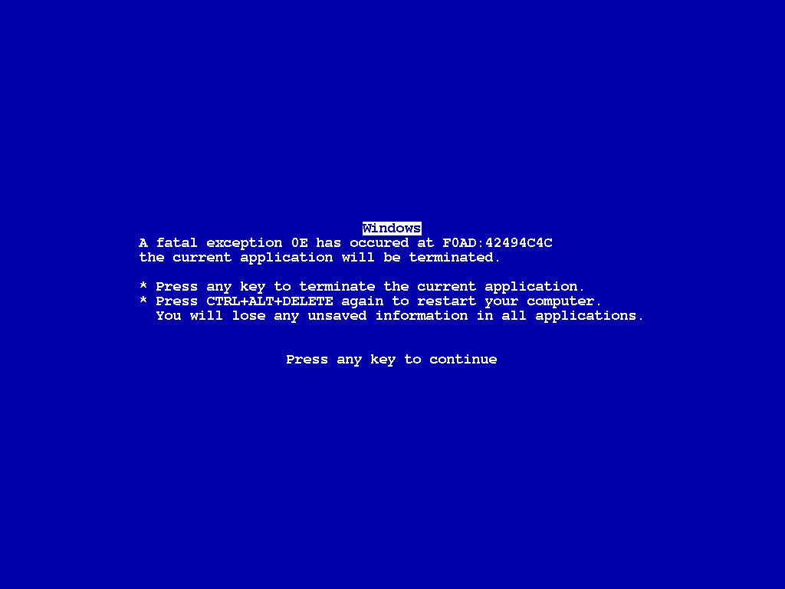
Notes:
The last thing we wanted was a situation where it all fell apart and ended up like this.

Slide 6
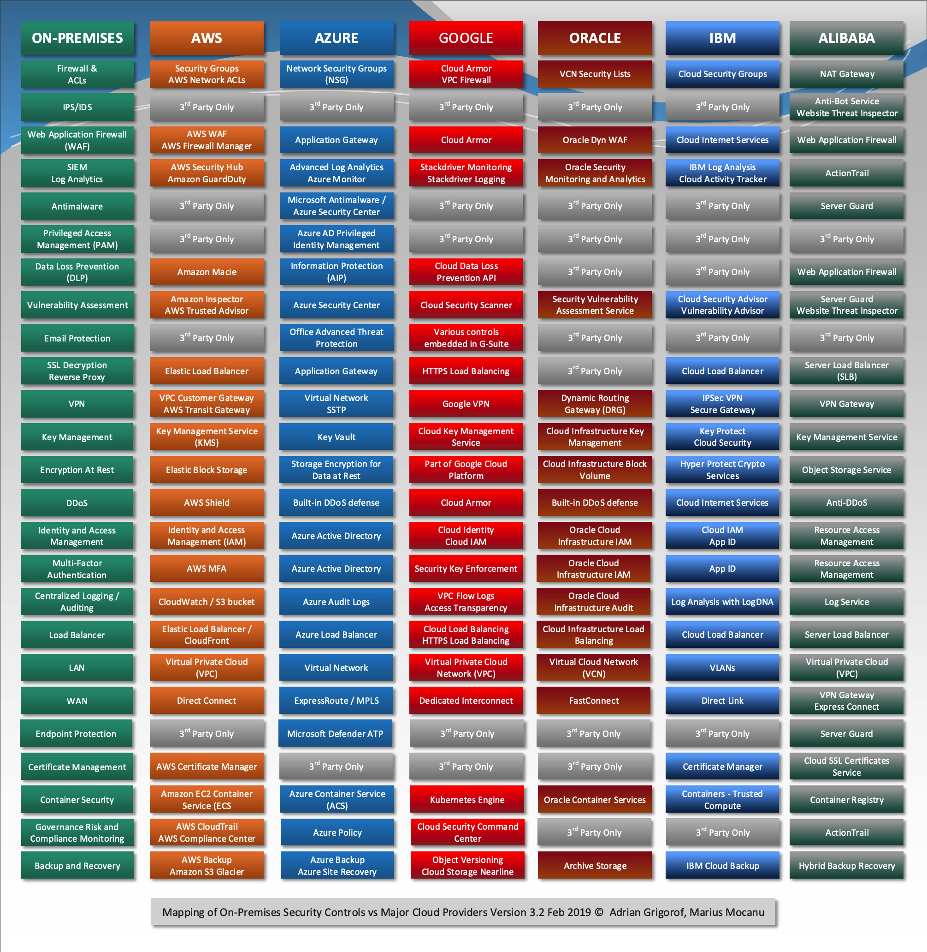
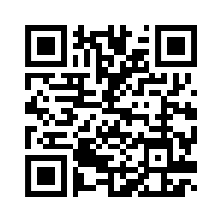
Terminology
http://www.eventid.net/docs/onprem_to_cloud.asp
Notes:
For those of you that are new, or haven’t seen it before, Adrian Grigorof and Marius Mocanu from EventID.net have a fantastic terminology mapper between platforms

Slide 7

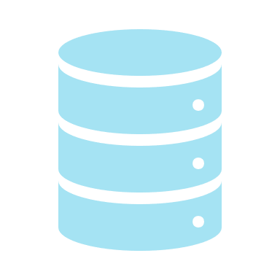




Management Plane
Data Plane
MicrosoftGraph API
Azure Resource Manager
(ARM)
Subscription
Resource Group
Portal
Azure Policy
PowerShell
Azure Policy
Resource
Developers
Users
CLI
Subscription
ARM
Template
Office 365
Audit Policy
Event Log
ARM
Template
Alert
Automation
Code
Notes:
So what does the Azure cloud look like?
You use either the portal, powershell or CLI to connect to the Microsoft Graph API
The Microsoft Graph API authenticates you to Azure AD, and Office365
Once authenticated, whichever action you undertake talks to Azure Resource Manager (ARM)
The action you go to take compares against the current Global Azure policy to determine if you’re permitted
Azure Policy can also be applied at the Resource Group level
If you try and do something that is against the Azure Policy it triggers the Audit Policy
All actions that have defied the Azure Policy will automatically get logged to the event log
All ALTER/DELETE/CREATE events are logged to the Event log by default
You can then get this to trigger an alert, execute an azure automation, which in turn can execute some code, or deploy an ARM template.
ARM Templates are a JSON representation of an Azure resource.
This means you can deploy things like a Network Security Group (NSG – Azure Firewall) to a resource after an alert.

Slide 8
Terminology
Tenant
Subscriptions (AWS Organisation)
Resource Group
Resource Group
Resources
Resources
Resources
Resources
Virtual Networks
(Virual Private Cloud)
Subnets
Subnets
Notes:
Azure consists of Tenants, Subscriptions, Resource Groups and Resources
I’ve put the equivalent AWS terms there for those more versed in that.
Microsoft have a handy website that literally translates AWS terms to Azure
A resource group is just a logical grouping of many resources
Storage
Managed Disks
File/Blob/Queue/Table
DataPool
Compute
Linux/Windows
PaaS Services – such as SQL
Azure Functions
LogicApps
Logs
Azure Security Center
Azure Operations Management Suite
Azure Sentinel (NEW)
Network
ExpressRoute – Virtual Private Networks
Vnets – Virtual Networks (typically one for a subscription, but can have more)
Subnets – Logical Addressing for Vnets (there’s no real concept of DHCP)
NetworkWatcher
Plus a bunch of Machine Learning/AI/Containers/Azure DevOps/AAD/Hybrid Services

Slide 9
Threat Modelling
Recon
Initial
Access
Execution
Persistence
Privilege
Escalation
Defence
Evasion
Discovery
Lateral
Movement
Exfil
Notes:
Obviously, to understand some of the threats you need to undertake some threat modelling
This means understanding how different parties are going to be using the cloud, and what resources they’ll use
From this we can then focus on techniques, detections and controls
Microsoft uses the STRIDE model (Spoofing, Tampering, Repudiation, Information Disclousure, Denial of Service and Elevation of Privileges)
The MITRE ATT&CK model is more common in the industry
Not a one-to-one for cloud systems, so needed to understand what techniques are missing to fill in the gaps
The important thing we learned is that these cloud systems are continuously evolving, which means we constantly need to threat model

Slide 10
Identity is King
Notes:
If there’s one thing to take away it’s this
As organisations mature they’re transitioning to a identity aware security model
It became obvious very quickly that there are a multitude of different ways to authenticate
No matter the method, once a user has authenticated, they have the capabilities their permissions have let out.
We have to remember we’re not talking about normal users here, but a management plane with the ability to control potentially critical resources in a resource group
ARM Details everything in Activity Logs – relating back to a user identifier
But was there a way to determine if a user account has been compromised from their activity?
From a Microsoft perspective, it was already game over when the credentials were obtained.
This lead to the follow up question: what could an attacker do with a compromised account, and what can a defender do to protect against it?

Slide 11
Recon & Initial Access
Hybrid Access – Your own network can be access vector
Azure Active Directory
Huge amount of OneDrive Phishing
  Multi-Factor Authentication is a must
Public Git Repos
  *.publishsettings
  Web.config
  App.config
  SAS Tokens
Notes:
No one can dispute that there are many ways to authenticate
Not as simple as just enabling multi-factor authentication – although would be foolish not to enable it!
SAS tokens, and different settings files all can contain keys that grant access
Comes back to securing your cloud environment is one small part of securing your CI/CD pipeline.
Once you’re authenticated, you’re limited to the RBAC permissions that have been allocated – it’s critical to ensure that these are as limited to the needs as possible.
Do users legitimately need the permission to create/alter/delete every possible component?
Huge amount of phishing around OneDrive/Office365 – all linked with AAD, which means possibility of pivoting in.
Be aware that if you’ve enabled MFA on an account, and they haven’t logged in to set it up, then MFA isn’t fully enabled.

Slide 12
Recon & Initial Access
By Default storage resources are anonymously internet accessible.
  http://mystorageaccount.blob.core.windows.net
The CI/CD pipeline is also a vector
Azure Magic Backplane addresses:
  169.254.169.254 – Hypervisor Metadata Endpoint
  168.63.129.16 – DNS and Azure health probes
  23.102.135.246 – KMS and License Activation
Notes:
Storage Accounts are anonymously accessible – great way to find information
Storage Accounts have a minimum of 8 characters and maximum of 24 characters for a name
Considering the code integration/code delivery pipeline is literally executing code, it’s a huge vector
The azure magic backplane allows for querying/signalling to the Azure hypervisor
This includes letting Azure know the host is active
Querying the Azure DNS server (unless a custom DNS is specified)
Health probes to Azure Load Balancers

Slide 13
Execution & Persistence
Azure Automation allows you to deploy powershell DSC code to all hosts in a subscription
  Including AWS and On-Site hosts
Azure Functions (AWS Lambda)
Azure Templates and Golden Images
Storage Accounts are a common choice for storing malicious content
Notes:
Azure ‘Run As Account’ – creates an Azure AD application with a service principal account,
Azure automation allows you to run python or powershell scripts from a known repo
But it’s very easy to add your own to this repo
Assigned contributor role for the subscription (although this can be changed) – allows full access
Azure Functions are the Azure equivalent to lambda
There are existing templates and golden images, can create your own managed image
Storage accounts can store content in 4 different ways – as blobs, files, tables and queues

Slide 14
Challenges
Understanding the terminology, capabilities and architecture
Tailoring a security program to take advantage of existing tools
  Forensics and IR Procedures and Tools
  Developing code
Ensuring you have the correct policy set
Ensuring access and permissions are correct
Constantly Evolving environment
Notes:
There’s a fair few challenges to be aware of before you begin
Obviously you have existing tools, methods and procedures – need to integrate the Azure environment into what have
This means it’s not too drastic a change to your existing methods
Keep in mind that you may not have access to the console (especially in the case where it’s serverless applications)
Microsoft can support you, but you need to understand what they can offer in the support contract
IAM/RBAC is critical – need to make sure it’s to your needs and identify key risk accounts
The environment is constantly changing – hosts come up and down all the time, new code is deployed often, and Microsoft introduce features often.
Different licenses will limit your features that you can use. E5 unlocks every feature, E3 loses access to a lot of security functionality.

Slide 15
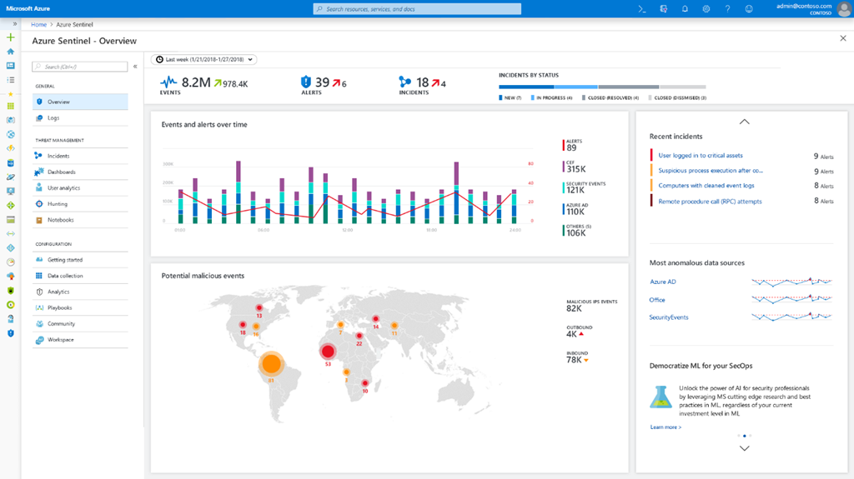
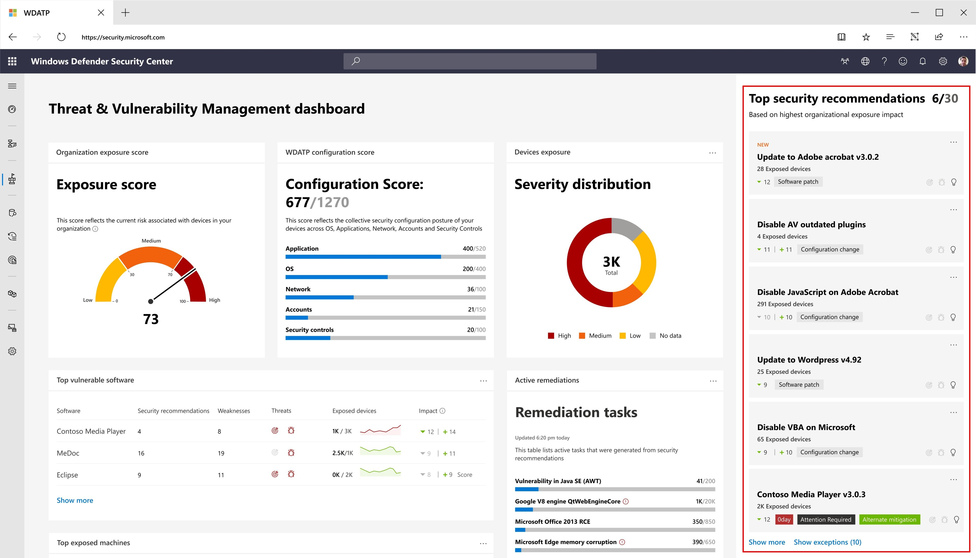
Constantly Evolving
Azure Sentinel
Azure ATP – Threat and Vulnerability
Notes:
Azure is a constantly evolving environment, there are large changes that take place often
Above are two of the biggest announcements – Azure Sentinel and Threat and Vulnerability assessments for ATP
This means you need to be constantly monitoring for changes
This could introduce new avenues for exploitation, or better ways for current monitoring and protection
There’s a huge battle in making sure that staff are kept up to date on the changes

Slide 16
Problems
Windows Defender vs. Microsoft Monitoring Agent
How can you monitor PaaS services?
A broad breadth of ever evolving services and features
Reliance on Machine Learning
  2-Week Window for Machine Learning Baseline
Notes:
Like all things, there are gaps – it just means having further controls to overlap and cover them.
At the end of the day we treat everything with zero trust – including the Microsoft Platform, and our users.
Microsoft relies heavily on machine learning for all of it’s alerts – there’s no real signature based methods
This is the case with the Advanced Threat Protection agent, or the PaaS services protection
There’s a two week window to build the baseline that’s used
If this baseline includes malicious behaviour, it’ll whitelist it automatically
There’s a priority for alerting as well. Microsoft Monitoring Agent is required to feed alerts from the system into Azure Security Centre
Security alerts that occur on a host will go to Windows Defender, and windows System Centre Configuration Manager (SCCM) if configured from there.
If this happens, it means that it won’t feed into Microsoft Monitoring Agent and Azure Security Centre
Any alerts that do make it past Windows Defender will make it to Azure Security Centre, and will be low fidelity, and more than likely a false positive.
Traditional EDR products won’t work for Platform as a Service (PaaS), so you will need to think about what security measures can be introduced into the CI/CD lifecycle.
How can you ensure that the repos you use are legitimate (Artifactory/Private Repos)
How can you ensure that’s being pushed is legitimate?
How can you ensure that the scripts to create resources haven’t been altered maliciously?
Is your Jenkins server literally hosted on Azure?

Slide 17
Solutions
Azure Security Centre
Advanced Threat Protection/Advanced Threat Detection
Logging Diagnostic Logs/OMS
Azure Policy and Compliance
Notes:
Azure Security Centre – Machine Learning based system, although it’ll only be as good as the data it gets.
Azure Security Centre is your first point for security incidents.
May need to develop solutions to fill gaps
Definitely need to consider your architecture when designing it.
Need to update architecture constantly as things change.
Lots of Opportunities to develop new security capabilities and experiment – including deception technologies.
If you’ve purchased the E5 license, you can leverage even more features such as Just in Time computing, and Privileged Identity Management

Slide 18
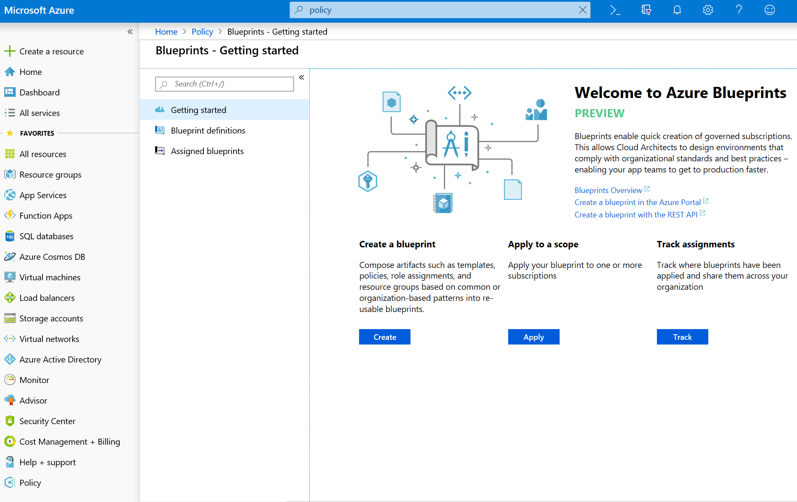
Policy
Notes:
I haven’t really covered policy so far, but it’s critical to Azure
It’s like group policy for Azure
A policy definition checks what to evaluate, and what action to undertake
It can be applied to a multitude of resources
An initiative is a collection of policies
Just because a new policy has been created doesn’t mean it has been applied.
Compliance reflects how many resources have currently implemented a policy.
You may need to redeploy a resource for the policy to be applied
Blueprints make deployment of all of this incredibly easy

Slide 19
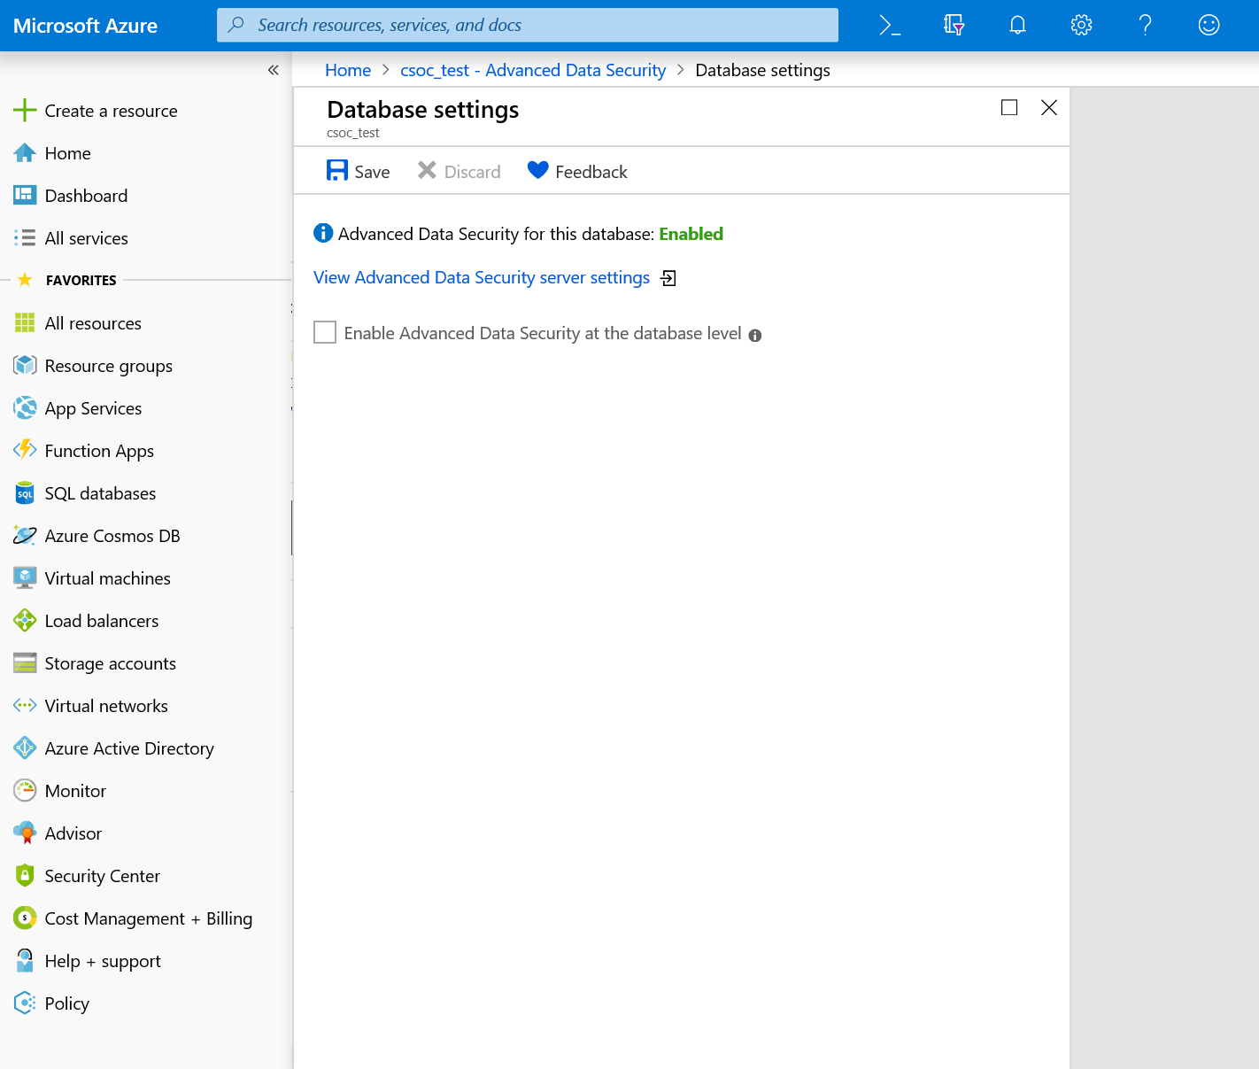
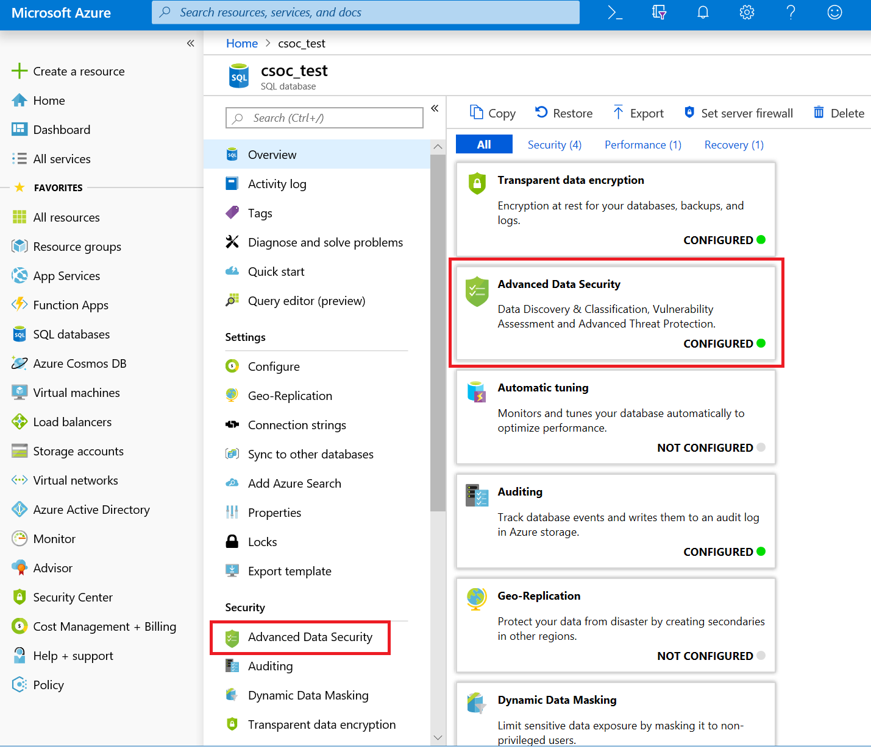
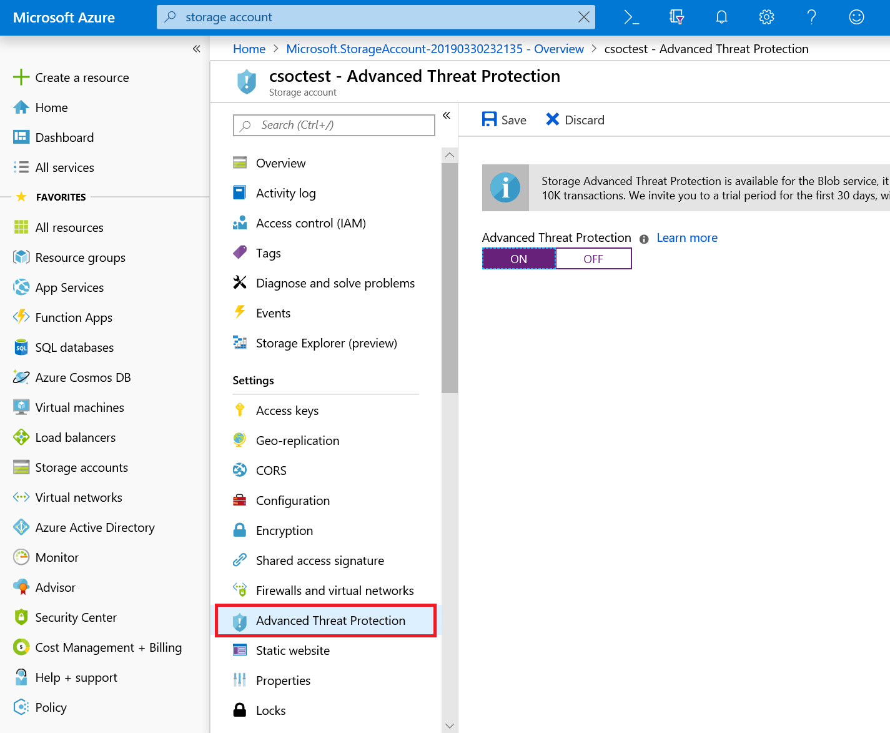
ATP/ATD
Advanced Threat Protection/Advanced Threat Detection for PaaS
Notes:
The naming convention is an utter confusion. Currently everything has been labelled Advanced Threat Prevention
Advanced Threat Prevention refers to a Microsoft Developed EDR solution that solely uses machine learning
Some of the PaaS services are switching to Advanced Threat Detection to differentiate between the endpoint agent and the security options, but not all have gotten there yet, so you may see references to Advanced Threat Prevention.
Advanced Threat Detection (PaaS services) – feeds into Azure Security Centre, but needs to be enabled
It’s currently only available to SQL PaaS services and blob component of storage accounts
For SQL PaaS services it alerts on SQL injection attempts (the SQL databases are directly internet accessible remember)
The Blob Storage alerts relate to suspicious access to the storage blob (such as unusual access attempts), not the storage of malicious files.
Has a minimum two week window to establish the benchmark.
Also has a small cost to them – be aware of this
The Advanced Threat Prevention EDR agent can only be deployed if you have an E5 license
Check out the tab in the menu.

Slide 20
Tips
Ensure Azure Policy and Compliant
Investigate Advanced Threat Protection/Advanced Data Security
Run practice simulations
Automate forensics where possible
Use current methods in conjunction with Azure tools
The Azure Activity Logs are your best friend
  Identity Protection is vital
A lot of great opportunities for Honeypots
Notes:
Some general tips and recommendations for you all
Don’t just create Azure Policy, ensure all your resources are compliant and that it’s being applied.
Policy changes all the time, make sure it’s still meeting your needs
For PaaS services Microsoft are deploying Advanced Threat Protection or Advanced Data Security – they have a cost, but they can generate alerts into Azure Security Centre
Run drills, ensure that your current methods are applicable
This includes calling Microsoft Support to ensure that what their capabilities are, and their timeframes are well known
Some forensic techniques may be against terms and conditions (procdumping memory for instance)
Develop code to make life easier for yourself
Make use of what you currently have in your environment, but leverage Azure tools where it assists.
The Azure activity logs are for all control plane events. They will give you information about every resource created, modified, or deleted by a user (no read though)
Azure AD logs will give great information about logins as well – including location, MFA and more.
The environment is perfect for someone wanting to set up honeytraps.

Slide 21
Lessons
Security starts from the Design up
Interaction with the Management Plane should be limited to as little as possible
IAM/RBAC is still king.
The cloud environment is one small part of the CI/CD lifecycle.
Security has to shift as fast as the environments they’re working with.
Notes:
Security needs to be designed from the ground up, the architecture is critical to limiting the scope and ensuring that only the required resources are accessible.
Remember this is a management interface, literally to control infrastructure in your network.
Security needs to learn to start implementing some of the DevOps/Agile practices to move as fast as the environment they’re trying to secure.

Slide 22
Code
https://github.com/
Notes:
I’ve put together some handy scripts to do some basic recon and changes – this could be affective for both Red and Blue teams

Slide 23
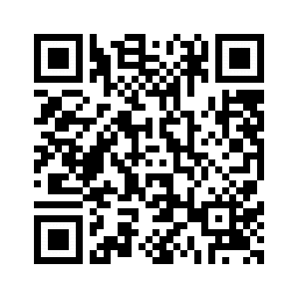

Further Reading
“Nailing Container Security in your CI/CD Pipeline”
David Grice – Bsides Melbourne 2019
“I’m in your cloud…reading everyone’s email”
Dirk-Jan Mollema – Troopers 2019
Notes:
Some amazing talks that have covered different parts of Cloud environments.
The Microsoft document is a labyrinth of great information – but it’s hidden in there.

Slide 24
Questions
Notes:
I just want to give a shout out to others who’ve presented at other cons, you’ve paved the way and made it look easy

